Slide 1

토깽이와 같이 배우는 NTFS 구조 분석 이정훈(Nuker)

Slide 2

누구인가?

Slide 3

INTRO
Using namespace : Yi Jung Hun
AGE : 0x14
이 친구는 특이하게도 술/담배/커피를 못한다
심지어 밥도 안 먹는다
(평균적으로 3일 걸러서 한끼 먹는다)
그래서 몸무게가 50Kg을 넘지 않는다(저체중)
이 친구의 자취방에는 가스 불이 나오지 않는다

Slide 4
INTRO
Name : 이정훈
Age : 21
Field : Digital Forensic / Crypto
Team : Anti-root / Beer CAT Security LAB
University : 인제대학교 (DOT-GABI 회장)
K - Shield. JR 2기 수료생 (現 대학생)
2018~2019 정보보호 학회(동계) 논문 투고
現 국가 암호 공모전 논문 작성 중

Slide 5
NTFS
1. Introduce
2. Introduction
3. Internals

Slide 6
This is so simple
Refer to Wikipedia

Slide 7
Introduce
Volume & Partition

Slide 8
Partition / Volume
Partition
Disk partitioning or Disk slicing is Creation of one or more regions on a hard disk or other secondary storage, so that an operating system can manage information in each region separately
Volume
In computer data storage, a volume or logical drive is a single accessible storage area with a single ﬁle system, typically
(though not necessarily)
resident on a single petition of a hard disk

Slide 9
Partition / Volume
Basic Structure
1Partition , 1Volume
Cf ( RAID, Floppy Disk)
Volume (C:\)
File system 1
Volume (D:\)
File system 2
Partition 1
Partition 2
DISK 1

Slide 10
Introduction
For N T F S

Slide 11
File System
What is the File System

Slide 12
File System
File system
The structure and logic rules used to manage
the groups of information and their names is called a
“File system”
In computing, a File System controls how data is stored or retrieved
Ex) NTFS , FAT12/16/32 , EXT2/3/4 , HFS …

Slide 13
Sector / Cluster
Sector
In computer disk storage, a sector is a subdivision of a track on a magnetic disk or optical disc.
The Sector is the minimum storage unit of a hard drive.
Operating System typically operate on blocks of data, which may span multiple sectors.

Slide 14
Sector / Cluster
Cluster
In computer ﬁle systems, a cluster of allocation unit is a unit of disk space allocation for ﬁles and directories.
A cluster is the smallest logical amount of disk space that can be allocated to hold a ﬁle.
The ﬁle system does not allocate individual disk sectors by default, but contiguous groups of sectors, called clusters

Slide 15
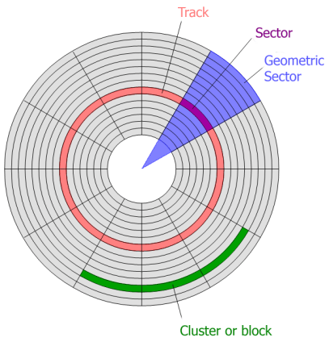
Disk Structure
Red : Track
Green : Cluster
Purple : Sector
Blue : Geometric Sector

Slide 16

Internals
START NTFS

Slide 17
Refer to forensic proof
Because I don’t have Computer

Slide 18
Internals – NTFS Architecture
Ntdlr.dll(XP)/Bootmgr(Vista7)
Put into CPU protected mode, start up options and initial menu settings
(C:\/C:\Windows\Boot\)
POST
MBR
Boot sector in VBR
NTFS.Sys
system file driver
(C:\Windows\System32\drivers\)
Ntoskrnl.exe
Obtaining System Device Driver
Load Information
(C:\Windows\System32\)
Ntldr/Booting
NTFS.sys
Ntoskrnl.exe
OS
Kernel Mode
User Mode
Application

Slide 19
Internals – NTFS Lay Out
$MFTMirr, $LogFile, $Root
$Bitmap, $Upcase, $Secure
$Boot, $AttrDef, $MFT
~ NTFS 3.0
$LogFile, $AttrDef
$MFT, $Secure
$MFTMirr, $Root
$Bitmap, $Secure
$Boot
NTFS 3.1 ~

Slide 20
Internals – NTFS VBR
VBR
MFT
Data Area
Structure
All data is managed in file form
VBR (Volume Boot Record) is in a fixed position
MFT typically exists after VBR
but can be anywhere in the data area

Slide 21
Internals – NTFS VBR
VBR
MFT
Data Area
Volume Boot Record
The area in front of the NTFS formatted partition
Save boot sector, NTLDR location information,
and additional boot code
The size of the VBR is the same as the cluster size

Slide 22
Internals – NTFS VBR
VBR
MFT
Data Area
Cluster Size
Boot
sector
NTLDR Information & Boot Strap
Number 0 Sector : Boot Sector
Remaining Sector : Additional Boot Code Information

Slide 23
Internals – NTFS VBR
VBR
MFT
Data Area
Cluster Size
Boot
sector
NTLDR Information & Boot Strap
3 bytes Jump Instruction
8 bytes OEM ID
25 bytes BPB

Slide 24
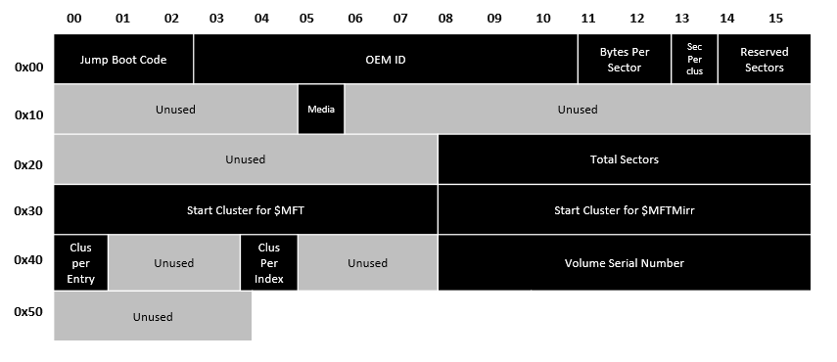
Internals – NTFS VBR

Slide 25
Internals – NTFS VBR

Slide 26
Internals – NTFS VBR

Slide 27
Internals – NTFS VBR

Slide 28
Internals – NTFS VBR

Slide 29
Internals – NTFS VBR

Slide 30
Internals – NTFS VBR

Slide 31
Internals – MFT
MFT(Master File Table)
NTFS is Type of management file (file, directory, meta information)
Typically 12.5% ​​of the volume is allocated to the MFT area
Meta information
such as location, attributes, time information, name, size, etc.
MFT(Master File Table) is All of the present(MFT Entry) in NTFS
MFT Area is Dynamically allocated based on the number of files
on the file system
MFT Entry number 0 ~ 15 is Reserved (special purpose)
areas created together with file system creation

Slide 32
Internals – MFT
VBR
MFT
Data Area
MFT
VBR
MFT
Data Area Data Area

Slide 33
Internals – MFT
VBR
Meta Data File
MFT entry 0
MFT entry 1
$MFT
MFT entry 2
$Logfile
…
MFT entry 15
$AttrDef
MFT entry 16
.
…
DATA
$Bitmap
$Boot
$Secure
$UsnJrnl

Slide 34
Internals – MFT
$MFT
MFT for MFT Entry
$Logfile
Information of Meta data transaction jrnl
$AttrDef
Information such as the attribute's identifier name size
.
Root directory for Volume
$Bitmap
Allocation information Cluster, from Volume
$Boot
(If possible booting) Boot Sector information
$Secure
File information (Security, Access control)
$UsnJrnl
Change information (File or Directory)

Slide 35
Internals – MFT
Boot Sector
Cluster 25
Volume Boot Record
Cluster 26
Cluster 27
$MFT
Cluster 25 -27, 80 -82
Cluster 80
Cluster 81
Cluster 82

Slide 36
Internals – MFT
MFT Entry
Header
Fix up
Array
Attributes
End Marker
Unused
Space
Header
Fix up
Array
Attributes
End Marker
Unused
Space
MFT Entry Header
In MFT Entry Meta Information of 48 Byte Area

Slide 37
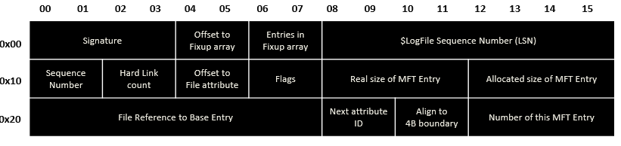
Internals – MFT
MFT Entry Header

Slide 38
Internals – MFT
MFT Entry Header

Slide 39
Internals – MFT
MFT Entry Header

Slide 40
Internals – MFT
MFT Entry Header

Slide 41
Internals – MFT
Base / Non Base MFT Entry
File Attribute Contents is so big, Using one more MFT Entry
Base MFT Entry
- First part of the MFT Entry
Non-base MFT Entry
- Etc part of the MFT Entry
Base MFT Entry
Non Base MFT Entry
Base MFT entry

Slide 42
Internals – MFT
File Reference Address
Sequence Value
MFT Entry Address
MFT Entries
Seq Num
File Reference Address
…
Num 1
Address
Num 1
…
Num 2
Address
Num 2
…
Address
Num 3
Num 3
…
Address
Num 4
Num 4
Num 5
Num 5
…
Address

Slide 43
Internals – MFT
MFT Entry(Fix up Array)
Header
Fix up
Array
Attributes
End Marker
Unused
Space
Fix up Array
- MFT Entry Judgement of the Integrity
- MFT Entry is 1,024 Byte , Use the 2 Sector
- Used Last of the Sector 2Byte , Creating Fixup Array

Slide 44
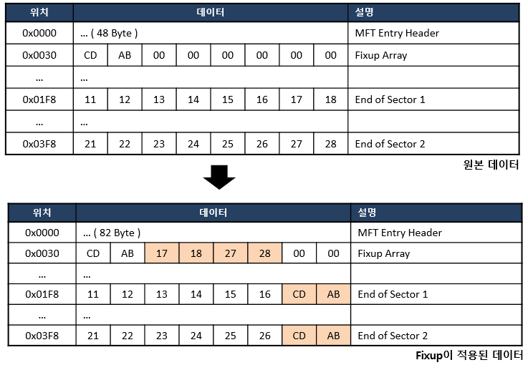
Internals – MFT

Slide 45
Internals – MFT

Slide 46
Internals – MFT
MFT Entry(Attributes)
Header
Fix up
Array
Attributes
End Marker
Unused
Space
$DATA
$BITMAP
$FILE_NAME
$INDEX_ROOT
$ATTRIBUTE_LIST
$INDEX_ALLOCATION
$STANDARD_INFORMATION
$LOGGED_UTILITY_STREAM

Slide 47
Internals – MFT
MFT Entry(Attributes)
Header
Fix up
Array
Attr
Header
Attr
Content
Attr
Header
Attr
Content
End Marker
Unused
Space
Each File (Name, Time, Property, Contents, etc) Expression
The name of Property Structure
- Each Property having Property Header and Property Contents
- Each File According to the characteristics Split Multiplex Property
- Property is According to size, Split Resident & Non-resident

Slide 48
Internals – MFT
MFT Entry(Attributes)
Attr Content
Attr
Header
Attr
Content
Attr
Header
Attr
Content
Attr
Header
Cluster Runs
End
Marker
Unused
Space
Resident : Immediately Behind Property Saved in Property (MFT Entry Inside)
$STANDARD_INFORMATION, $FILE_NAME
Non-resident : Property Contents is so many Saved Other Cluster
(MFT Entry Outside) $ATTRIBUTE_LIST, $DATA
- $DATA Property instance
File size < 700 Byte : Resident Property
File size > 700 Byte : Non-resident Property

Slide 49
Internals – MFT
MFT Entry(Attributes - Common Header)
Attr
Header
Attr
Content
Attr
Header
Attr
Content
Attr
Header
Attr
Content
End
Marker
Unused
Space
Each Property is Expression for Meta information,
Have a Header
Extraneous Property form Common 16 Byte Header
+ According to Property form(Resident/Non-resident)
More Header

Slide 50
Internals – MFT
MFT Entry(Attributes – Common Header)
Length of Name
Flags
Offset to Name
Length of Attribute
Non-Resident Flag
Attribute Type Identifier
Attribute Identifier

Slide 51
Internals – MFT
MFT Entry(Attributes – Common Header)
Length of Name
Flags
Offset to Name
Length of Attribute
Non-Resident Flag
Attribute Type Identifier
Attribute Identifier

Slide 52
Internals – MFT
MFT Entry(Attributes – Common Header)
Length of Name
Flags
Offset to Name
Length of Attribute
Non-Resident Flag
Attribute Type Identifier
Attribute Identifier

Slide 53
Internals – MFT
MFT Entry(Attributes – Common Header)
Length of Name
Flags
Offset to Name
Length of Attribute
Non-Resident Flag
Attribute Type Identifier
Attribute Identifier

Slide 54
Internals – MFT
MFT Entry(Attributes – Common Header)
Length of Name
Flags
Offset to Name
Length of Attribute
Non-Resident Flag
Attribute Type Identifier
Attribute Identifier

Slide 55
Internals – MFT
MFT Entry(Attributes – Common Header)
Length of Name
Flags
Offset to Name
Length of Attribute
Non-Resident Flag
Attribute Type Identifier
Attribute Identifier

Slide 56
Internals – MFT
MFT Entry(Attributes – Common Header)
Length of Name
Flags
Offset to Name
Length of Attribute
Non-Resident Flag
Attribute Type Identifier
Attribute Identifier

Slide 57
Internals – MFT
MFT Entry(Attributes – Common Header)
Length of Name
Flags
Offset to Name
Length of Attribute
Non-Resident Flag
Attribute Type Identifier
Attribute Identifier

Slide 58
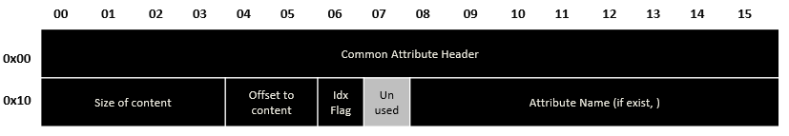
Internals – MFT
MFT Entry(Attributes – Resident Attribute Header)
Attribute Name
Size of Content
Offset to Content
Indexed Flag

Slide 59
Internals – MFT
MFT Entry(Attributes – Resident Attribute Header)
Attribute Name
Size of Content
Offset to Content
Indexed Flag

Slide 60
Internals – MFT
MFT Entry(Attributes – Resident Attribute Header)
Attribute Name
Size of Content
Offset to Content
Indexed Flag

Slide 61
Internals – MFT
MFT Entry(Attributes – Resident Attribute Header)
Attribute Name
Size of Content
Offset to Content
Indexed Flag

Slide 62
Internals – MFT
MFT Entry(Attributes – Resident Attribute Header)
Attribute Name
Size of Content
Offset to Content
Indexed Flag

Slide 63
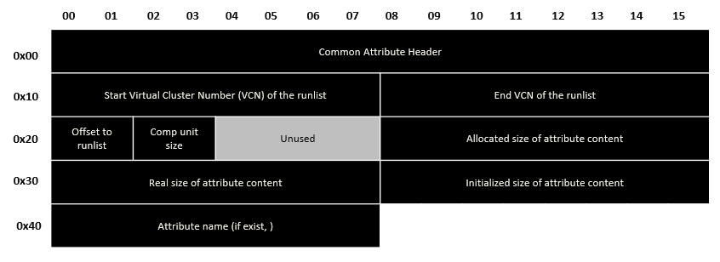
Internals – MFT
MFT Entry(Attributes – Non Resident Attribute Header)

Slide 64
Internals – MFT
MFT Entry(Attributes – Non Resident Attribute Header)

Slide 65

Internals – MFT
MFT Entry(Attributes – Non Resident Attribute Header)
Attr
Header
Attr
Content
Attr
Header
Attr
Content
Attr
Header
Cluster Runs
End
Marker
Unused
Space
1
3
1220
2
3072
4
Start cluster
Length

Slide 66
Internals – MFT
MFT Entry(Attributes – Non Resident Attribute Header)
Attr
Header
Attr
Content
Attr
Header
Attr
Content
Attr
Header
Cluster Runs
End
Marker
Unused
Space
1
Attribute Content
1
3
1220
LCN : 1220 1221 1222
VCN : 0 1 2
2
3072
4
Start cluster
Length
2
Attribute Content
LCN : 3072 3073 3074 3075
VCN : 3 4 5 6

Slide 67
Internals – MFT
MFT Entry(Attributes – Non Resident Attribute Header)
Attr
Header
Attr
Content
Attr
Header
Attr
Content
Attr
Header
Attr
Content
End
Maker
Unused
Space
$FILE_NAME
$DATA
$STANDARD_INFORMATION
Common File is have a 3 Property
$STANDARD_INFORMATION : Produced File/Access/Retouch Time/Owner/etc
$FILE_NAME : File Name(Unicode), File Property/Access/Time of Retouch
$DATA : File Contents
- If $ Since Capital letter, Property Name
- If $ Since Only First letter is Capital letter, Meta Data File (Except $MFT)

Slide 68
Internals – MFT
MFT Entry(ADS – Alternate Data Stream)
Header
Fix up
Array
$STANDARD_INFO
$FILE_NAME
$DATA
End Marker
Unused
Space
$ DATA Property Supports more than
2 property stream (Windows NT 3.1.Ver ~)
- NTFS Sever Supporting for Mac OS(HFS) Client
- More Property Stream(ADS) is Access to Property Name
- ADS is must have Property name (Basic Stream does not matter)
- ADS Property is Not include File Size
$DATA
(main)
$DATA
(Alternate)

Slide 69

INDEX_Structure
Yes!!

Slide 70
Internals - INDEX
10
18
30
3
8
9
20
21
35
50
15

Slide 71
Internals - INDEX
$INDEX_ROOT
INDEX_ENTRY
$FILE_NAME
INDEX_ENTRY
Indexed
Contents
$SDH
INDEX_ENTRY
$SII
INDEX_ENTRY
$O (Object ID)
INDEX_ENTRY
$O (Owner ID)
INDEX_ENTRY
$Q (Quota)

Slide 72
Internals - INDEX
$INDEX_ROOT
INDEX_ROOT
$I30
INDEX_ENTRY
INDEX_ENTRY
INDEX_ENTRY
INDEX_ENTRY
End Of Node
INDEX_ENTRY
INDEX_ENTRY
$INDEX_ALLOCATION
Cluster Run
INDEX_ENTRY
…
…

Slide 73
Internals - INDEX
$I30
$INDEX_ROOT
End Of Node
(VCN 0)
INDEX_ENTRY
INDEX_ENTRY
$INDEX_ALLOCATION
INDEX_ENTRY
Cluster Run
…

Slide 74
Internals - INDEX
$I30
$INDEX_ROOT
INDEX_ENTRY
End Of Node
(VCN 0)
INDEX_ENTRY
…
End Of Node
(VCN 1)
INDEX_ENTRY
$I30
INDEX_ENTRY
$INDEX_ALLOCATION
INDEX_ENTRY
Cluster Run
INDEX_ENTRY

Slide 75
Reference
http://forensic-proof.com/archives/431
http://forensic-proof.com/archives/590
https://m.blog.naver.com/bitnang/70184195032
http://forensic-proof.com/archives/584
http://forensic-proof.com/archives/470
https://horensic.tistory.com/116
https://ko.wikipedia.org/wiki/NTFS
http://forensic-proof.com/archives/435
https://www.tabmode.com/windows10/mbr-gpt.html
http://www.ktword.co.kr/word/abbr_view.php?m_temp1=4851
http://forensic-proof.com/archives/355
https://movie.daum.net/moviedb/main?movieId=94828

Slide 76
TO DAY TMI
(Too Much Information)

